Slide 1

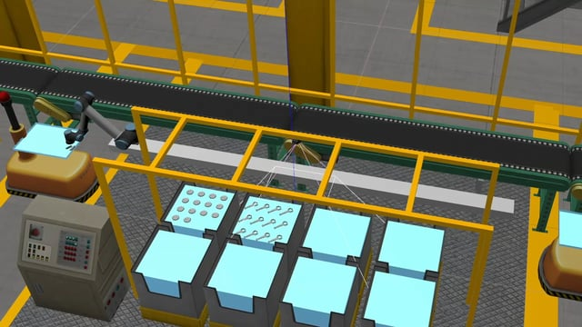

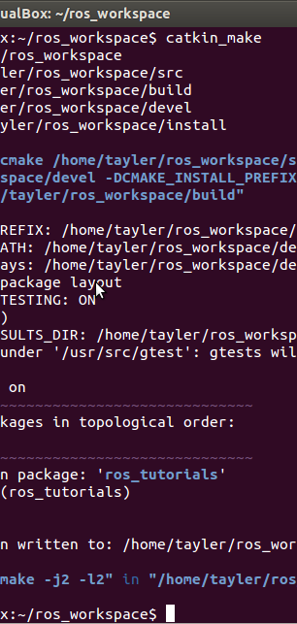
ARIAC Project
Group 3
Qual 2a

Slide 2
Outline
Qualifier 2 -
Part A: A simplified version of Scenario 2: Dropped Part.
One of the parts is picked up from the bin, it is dropped back into the bin/tray. Then is retrieved again, in order to complete the order.

Slide 3
Qual 2
Part A: Dropped Part.
Kit Segregation
Part dropped at correct location and with correct pose
Added redundancy for dropped part, such that it will pick it up and place it back at the correct position.
Collision avoidance

Slide 4
References
https://bitbucket.org/osrf/ariac/src
http://gazebosim.org/ariac

